Slide 1
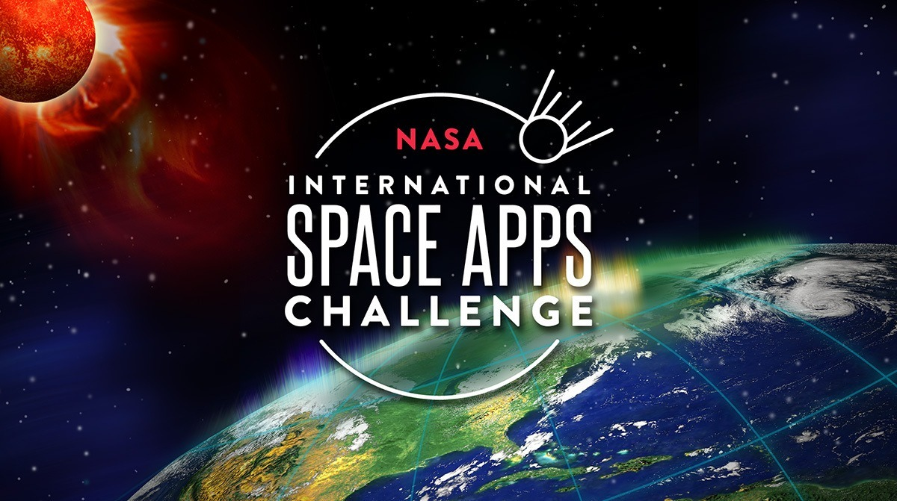

Slide 2

BINARY_BRAINS
CHALLENGE NAME
HOW CLIMATE CHANGE EFFECTS US
TEAM MEMBERS : 1. AYUSH SHARMA
2. JHANVI JINDAL

Slide 3
POTENTIAL CONSIDERATIONS
WHAT IS CLIMATE CHANGE?
CAUSES OF CLIMATE CHANGE
EFFECTS OF CLIMATE CHANGE ON HUMANS
ROLE OF NASA IN PREVENTING CLIMATE CHANGE
PREVENTIONS OF CLIMATE CHANGE

Slide 4
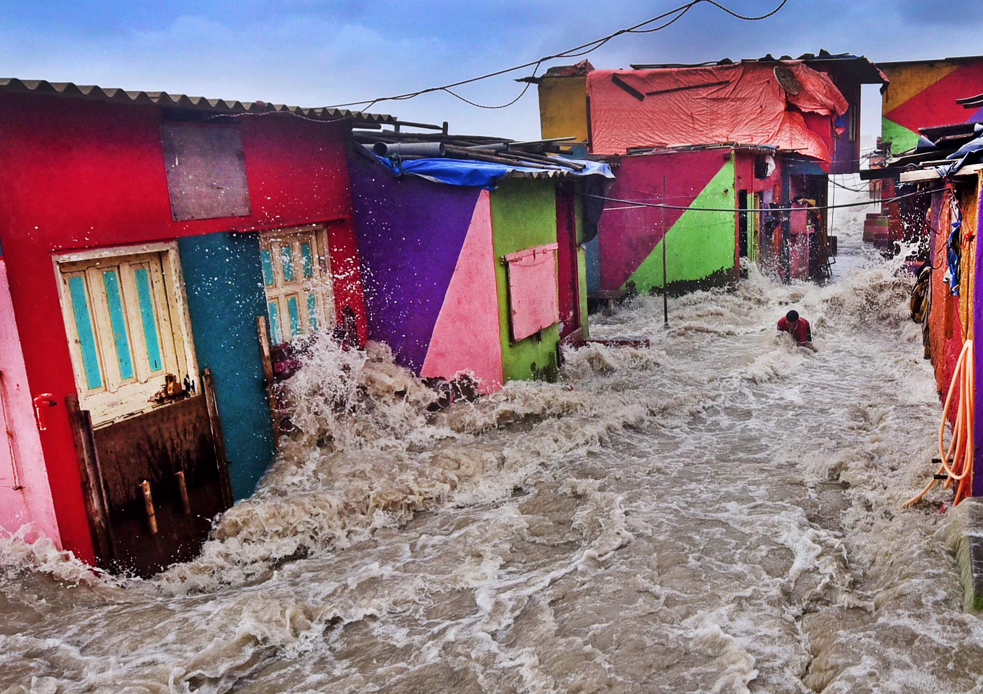
WHAT IS CLIMATE CHANGE?
Climate change describes a change in the average conditions — such as temperature and rainfall — in a region over a long period of time. For example, 20,000 years ago, much of the United States was covered in glaciers.
In the United States today, we have a warmer climate and fewer glaciers . Global climate change refers to the average long-term changes over the entire Earth.
These include warming temperatures and changes in precipitation, as well as the effects of Earth’s warming, such as:
Shrinking mountain glaciers
Ice melting at a faster rate than usual in Greenland,
Antarctica and the Arctic
Changes in flower and plant blooming times.

Slide 5
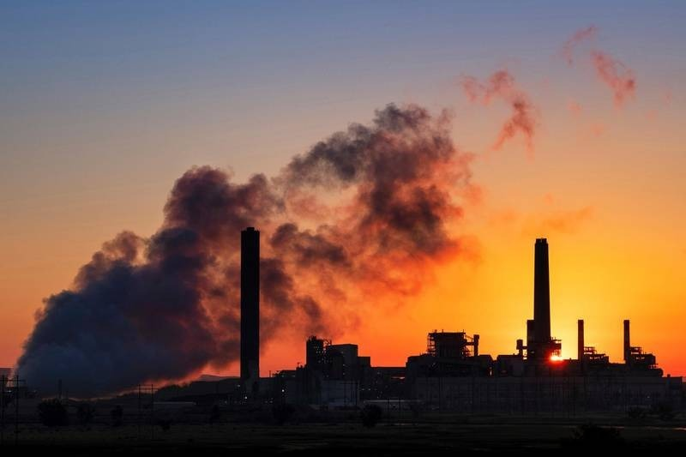
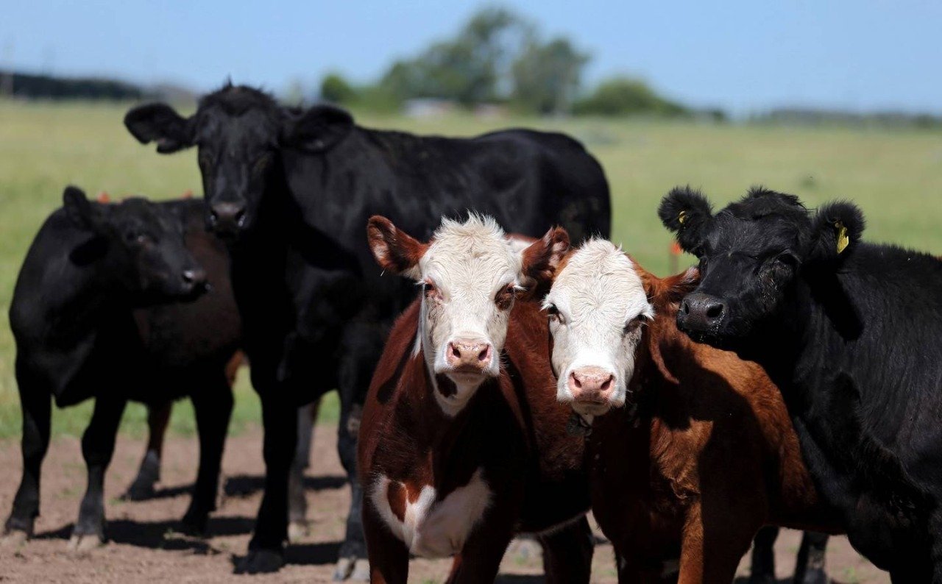
CAUSES OF CLIMATE CHANGE
Fossil fuels :
Gases such as carbon dioxide and methane trap heat in
the Earth’s atmosphere. They are mostly created by humans
burning fossil fuels – coal, oil, wood and natural gas. Climate
change activists say humans must stop burning these energy
sources
Increasing livestock farming :
A growing demand for meat has led to intensive agriculture
Of animals. Cows and sheep produce large amounts of
methane when they digest their food, and this gas adds to the
Green house effect on the Earth.

Slide 6
EFFECTS OF CLIMATE CHANGE ON HUMANS
Hotter temperatures
As greenhouse gas concentrations rise, so does the global surface temperature. The last decade, 2011-2020, is the warmest on record. Since the 1980s, each decade has been warmer than the previous one.
More severe storms
Destructive storms have become more intense and more frequent in many regions. As temperatures rise, more moisture evaporates, which exacerbates extreme rainfall and flooding, causing more destructive storms.
Increased drought
Climate change is changing water availability, making it scarcer in more regions. Global warming exacerbates water shortages in already water-stressed regions and is leading to an increased risk of agricultural droughts affecting crops,.

Slide 7
ROLE OF NASA IN PREVENTING CLIMATE CHANGE
In addition to collecting information about the Earth, NASA also builds global and regional climate models to understand the causes and effects of climate change, including global warming. NASA shares its climate data and information with the public and policy leaders freely and in a timely manner.
From NASA GISS’ E3 climate model to NASA GMAO’s Goddard Earth Observing System (GEOS) model, scientists use near real-time to long-term records of NASA observations as input to help initialize, develop model parameters, and validate these climate models.

Slide 8
PREVENTIONS OF CLIMATE CHANGE
There are always things that we can do to fight against climate change:
Make Your Commute Green
Be More Conservative with Energy Usage
Get Active and Vote
Recycle
Educate Yourself and Others
Encourage the use of renewable energies

Slide 9


